Slide 1
Who do you think you are? Discovering and developing reflective and relationship-based practice
Gillian Ruch Professor of Social Work
University of Helsinki
November 2018

Slide 2
Where are we heading?
Why emotions matters
Principles of emotionally integrated practice
Obstacles to emotionally integrated practice
Sustaining emotionally integrated practice

Slide 3
Why emotions matter in practice
Social work involves responding to distress, damage and trauma - difficult feelings and emotional pain
All relationships involve emotions - a coming together, a being together and a separation
Always two sides – ‘both and’- strengths perspective

Slide 4
Core principles of an emotionally informed approach
It recognises that each social work encounter is unique
It understands that human behaviour is complex and multifaceted, i.e. people are not simply rational beings but have affective – conscious and unconscious – dimensions that enrich but simultaneously complicate human relationships
It focuses on the inseparable nature of the internal and external worlds of individuals and the importance of integrated – psycho-social – as opposed to polarised responses to social problems
.

Slide 5
Core principles of an emotionally informed approach
It accepts that human behaviours and the professional relationship are an integral component of any professional intervention
It places particular emphasis on ‘the use of self’ and the relationship as the means through which interventions are channelled (Ruch, 2018)

Slide 6
Core principles of an emotionally informed approach
‘As a social worker you have to be capable of thinking simultaneously about:
the uniqueness of each individual service user
the relationship of service users to their social circumstances
your relationship with individual service users
your relationship with the socio-political context in which you practise’ (Wilson et al, 2009:3).

Slide 7
Relationship-based practice and emotions
Relationships
Emotions

Slide 8
Anxiety
What makes it difficult to
hold emotions in mind?

Slide 9
Obstacles to emotionally informed and relationship-based practice: Anxiety and risk
Risk
Anxiety

Slide 10
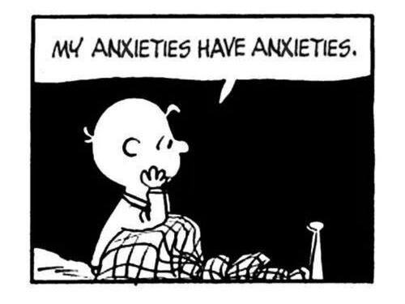
Anxiety

Slide 11
Obstacles to emotionally informed practice: Anxiety, risk and austerity
Financial austerity
Financial accountability
Austere practice
Anxiety and inefficiency
Professional reductionism
The Austerity Cycle

Slide 12
Austerity, Anxiety and Emotion
So not just financial austerity but emotional austerity
Dysfunction and distress - anxiety - defensive practice
Compounded by contemporary trends (Cain, 2012; Sandel, 2012; Turkle, 2010)
Notes:
2010 University of Michigan study showed Students were 40% less empathic than they were 30 years ago and much of drop since 2000. Trend attributed to social media, reality TV and ‘hyper competitiveness’ (Cain, 2012)
We don’t have a market economy, we are a market economy’ (Sandel, 2012)

Slide 13
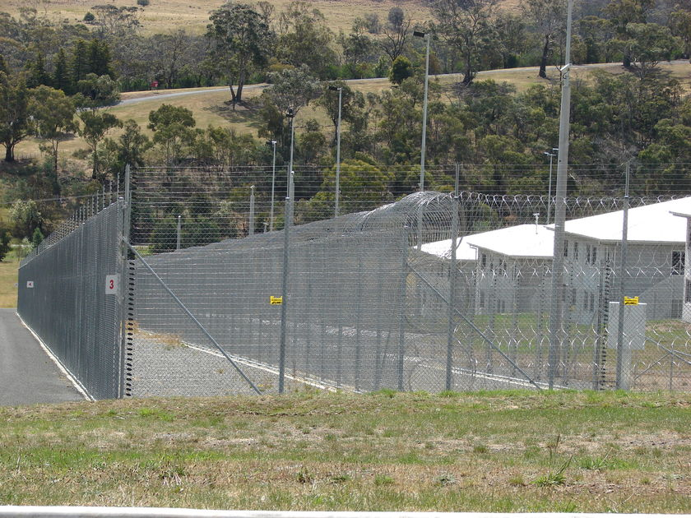

Slide 14
Front door and wellbeing
WELLBEING: the state of being comfortable, healthy, or happy.
synonyms:welfare, health, good health, happiness, comfort, security, safety, protection, prosperity, profit, good, success, fortune, good fortune, advantage, interest, prosperousness, successfulness

Slide 15
Characteristics of Emotionally Austere Practice
Certain
Simple
Risk-free and averse
Doing
Cognitive/Rational
Objective
Outcome-driven
Techno-bureaucratic compet.
Uncertain
Complex
Risk-ridden and tolerant
Being
Affective/Irrational
Subjective
Relationship-based
Emotional intelligence

Slide 16
Sustaining emotionally informed practice

Slide 17
Austere Anxious Avoidance
What is it, at root, that is being avoided?... Of particular relevance are frequent examples of “turning a blind eye” – that is failing to see what is before one’s eyes because to do so would cause too much psychic disturbance – and of various forms of “attacks on linking” – that is systematic disconnection between things which logically belong together, again a defence which is employed because to make the link would be a source of painful anxiety (Rustin, 2005:12).

Slide 18
Social systems as defences against anxiety
Menzies-Lyth (1988) - seminal work
Armstrong and Rustin, 2014; Lees et al, 2012; Taylor et al, 2008; Whittaker, 2011 - contemporary versions

Slide 19
Contemporary examples of social systems as defences against anxiety
Proliferation of policies and procedures - bureaucratisation of practice
Performance indicators and audit
IT systems - ‘from the relational to the informational’ (Parton, 2008)
Case management supervision
Diminished professional responsibility and delegated decision-making

Slide 20
Anxiety and containment: Sustaining emotionally- informed, reflective and relational practice

Slide 21
The inter-dependent characteristics of integrated contemporary practice ©Gillian Ruch2014
Feeling
Doing
Thinking
Reflective and
relationship-based
leaders and practitioners

Slide 22
The inter-dependent characteristics of integrated contemporary practice ©Gillian Ruch2014
Thinking
Feeling
Doing

Slide 23
Emotionally integrated practice ©Gillian Ruch2014
Emotional
‘feeling’ containment
Organisational
‘doing’ containment
Epistemological ‘knowing’ containment
Holistic containment
creates emotionally
intelligent and
reflective leaders
and practitioners
degree degree

Slide 24
Sustaining emotionally informed practice

Slide 25
References
Cooper, A. (2010) What future? Organisational Forms, Relationship-based Social Work Practice and the Changing World Order, in Ruch, G., Turney, D. and Ward, A. (eds) Relationship-based social work: getting to the heart of practice, London: Jessica Kingsley.
Foster, A. (2013) The Challenge of Leadership in Front Line Clinical Teams Struggling to Meet Current Policy Demands, Journal of Social Work Practice, 7, 2, 119–131,
Hingley,-Jones, H. and Ruch, G. (2016) Stumbling through? Relationship-based social work practice in austere times, Journal of Social Work Practice, 30, 3, 235-248
Lees, A. (2013) From Menzies-Lyth to Munro: the Problem of Managerialism, British Journal of Social Work, 43, 542–558.
Parton, N. (2008) Changes in the Form of Knowledge: from the Social to the Informational, British Journal of Social Work, 38, pp. 253-269.
Pithouse, A., Hall, C., Peckover, S. and White, S. (2009) A on Assessment Framework, British Journal of Social Work, 39, pp. 599-612.

Slide 26
References
Sandel, M. (2012) What Money Can’t Buy: The moral limits of markets, London, Penguin.
Stokes, J. (1994) ‘The Unconscious at Work in Groups and Teams’, in Obholzer, A. and Zagier-Roberts, V. (eds) The Unconscious at Work, London, Routledge.
Taylor, H., Beckett, C. and McKeigue, B. (2008) Judgements of Solomon: anxieties and defences of social workers involved in care proceedings, in Child and Family Social Work, 13, 1 pp.23-31.
Whittaker, A. (2011): Social defences and organisational culture in a local authority child protection setting: challenges for the Munro Review?, Journal of Social Work Practice, 25:4, 481-495.
Zagier-Roberts, V. (1994) ‘The Organisation of Work: Contributions from Open Systems Theory’, in Obholzer, A. and Zagier-Roberts, V. (eds) The Unconscious at Work, London, Routledge.

Slide 27
Resources
JOURNAL ARTICLES
Ruch. G. (2007) 'Thoughtful' Practice: Child Care Social Work and the Role of Case Discussion, Child and Family Social Work, 12, 370-379.
Ruch, G. (2005) Relationship-based and Reflective Practice in Contemporary Child Care Social Work, Child and Family Social Work, 10.
RELEVANT CHAPTERS IN EDITED BOOKS
Ruch, G. (2018) ‘The contemporary context of relationship-based practice’, in Ruch, G., Turney, D. and Ward, A. (eds) Relationship-based social work: getting to the heart of practice, 2nd edition, London: Jessica Kingsley.
Ruch, G. (2018) ‘Theoretical Frameworks Informing Relationship-Based Practice’ in Ruch, G., Turney, D. and Ward, A. (eds) Relationship-based social work: getting to the heart of practice, 2nd edition, London: Jessica Kingsley.

